Slide 1
Road Accident Severity Classification Using US Accidents Dataset
Project for CSE 5523: Machine Learning and Statistical Pattern Recognition
Team Members:
Yuvraj Singh
Abdirashid Dahir

Slide 2
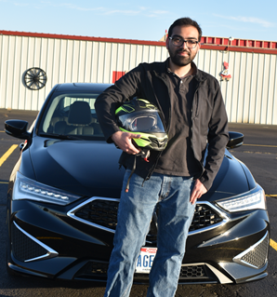

Team Introduction
Yuvraj Singh
Second Year PhD Student at OSU Center for Automotive Research
Abdirashid Dahir
First Year PhD Student at OSU Department of Geography

Slide 3
Contents
Y
Dataset Description
Feature selection
Correlation with target variable
Mutual Information
Base model from literature: Logistic Regression
Why did we use confusion matrices for model evaluation?
Classification performance metrics: user/producer accuracy, kappa coefficient
Resample training data
Algorithms
Random Forest with Bootstrap Aggregation
Random Forest with Adaptive Boosting
Perceptron: One vs All and One vs One
Support Vector Machines: One vs All and One vs One
Neural Networks: fully connected multi-layer neural networks
Future Work

Slide 4
Dataset Description and Pre-Processing

Slide 5
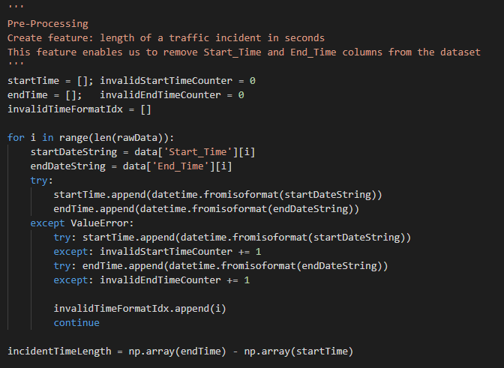
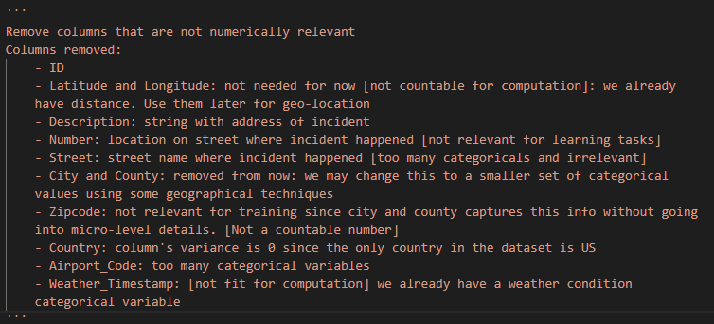
Dataset Description
Y
Total observations in raw data: ~ 1.5 million
Data cleaning: cleanData.py
Remove irrelevant columns (refer screenshot on right)
Calculate incident time by subtracting end and start timestamps (in ISO time format)
Remove all NaN values
Total observations retained after data cleaning: ~ 900k

Slide 6
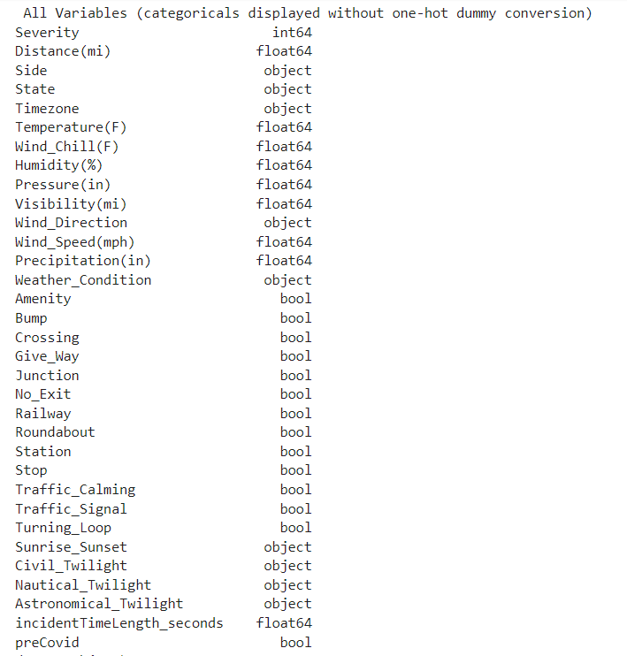
Variables in Raw Data
A
Severity (first column) is the target variable.
Severity classes: low (2), medium (3), high (4)
Very minor accidents (class 1) is merged with class low (2) because of low number of observations.
The Boolean “preCovid” was used to identify whether the incident happened before or after February 2020. This variable was found to be correlated with severity.

Slide 7
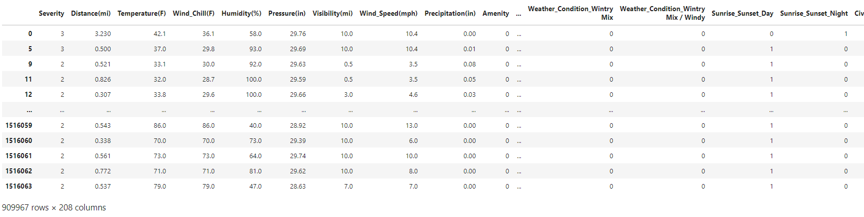
Screenshot of Raw Data
A
After converting categorical predictors to one-hot variables, we have 207 predictor variables.

Slide 8
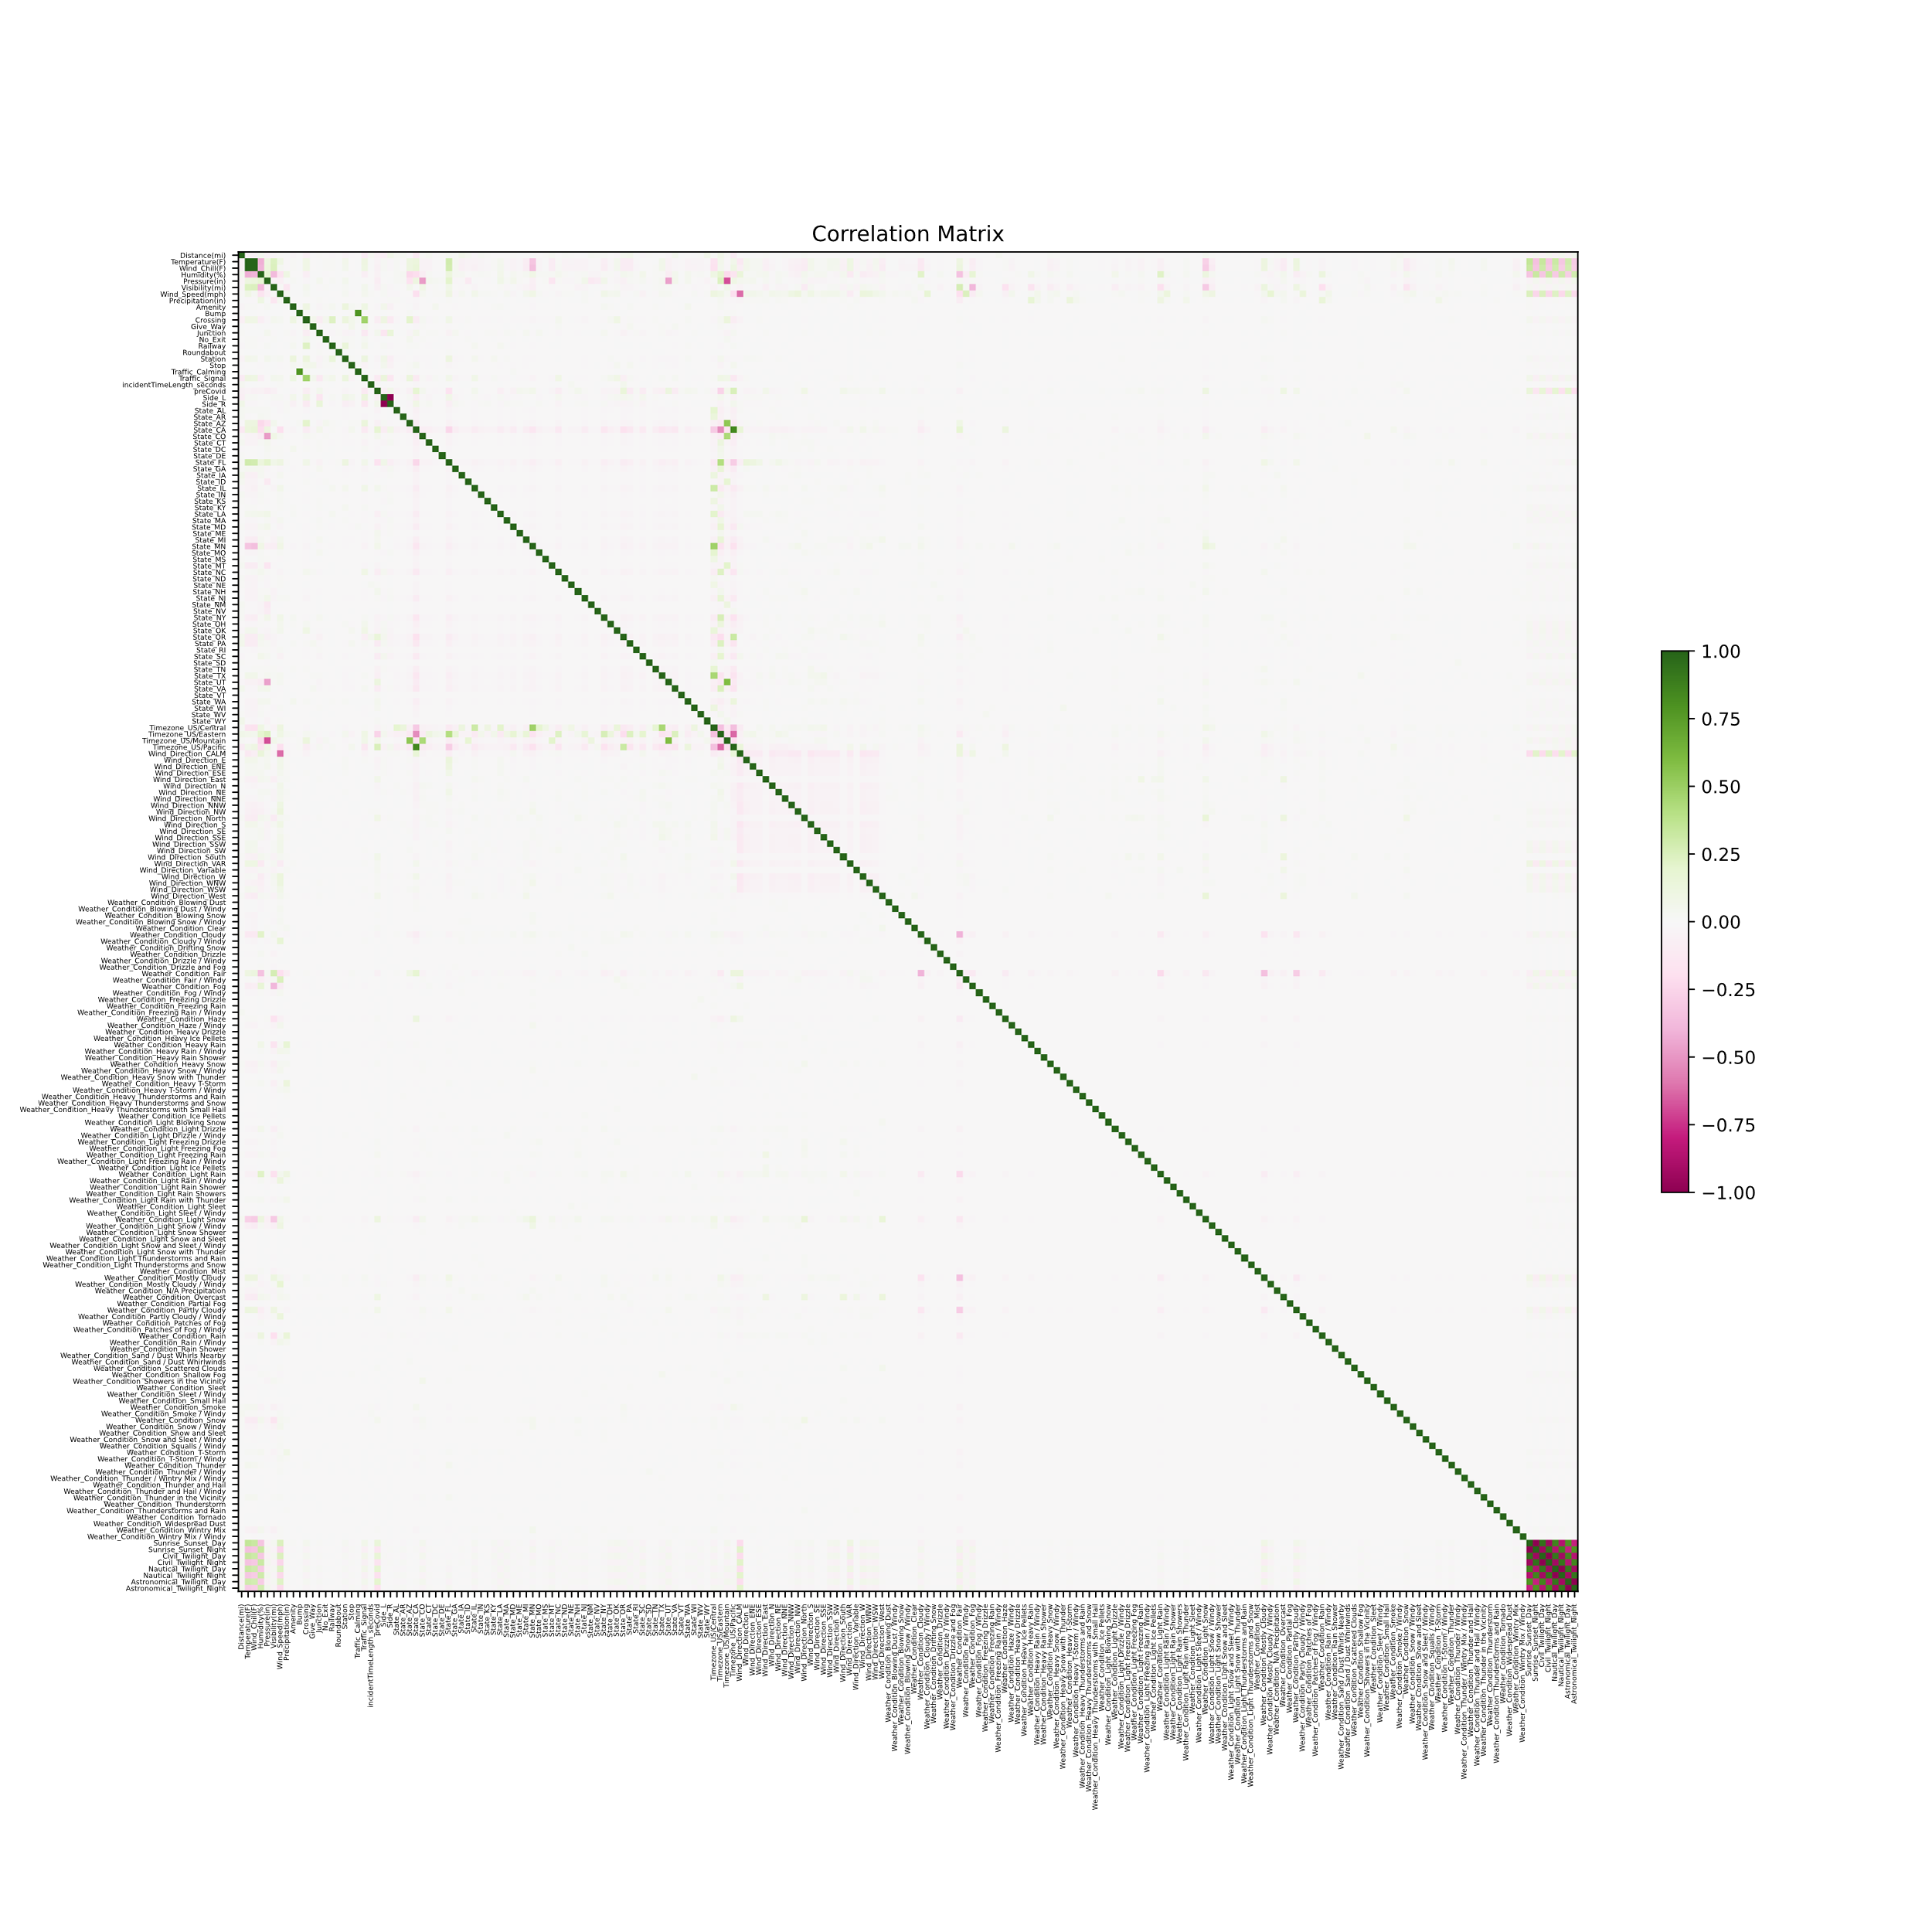
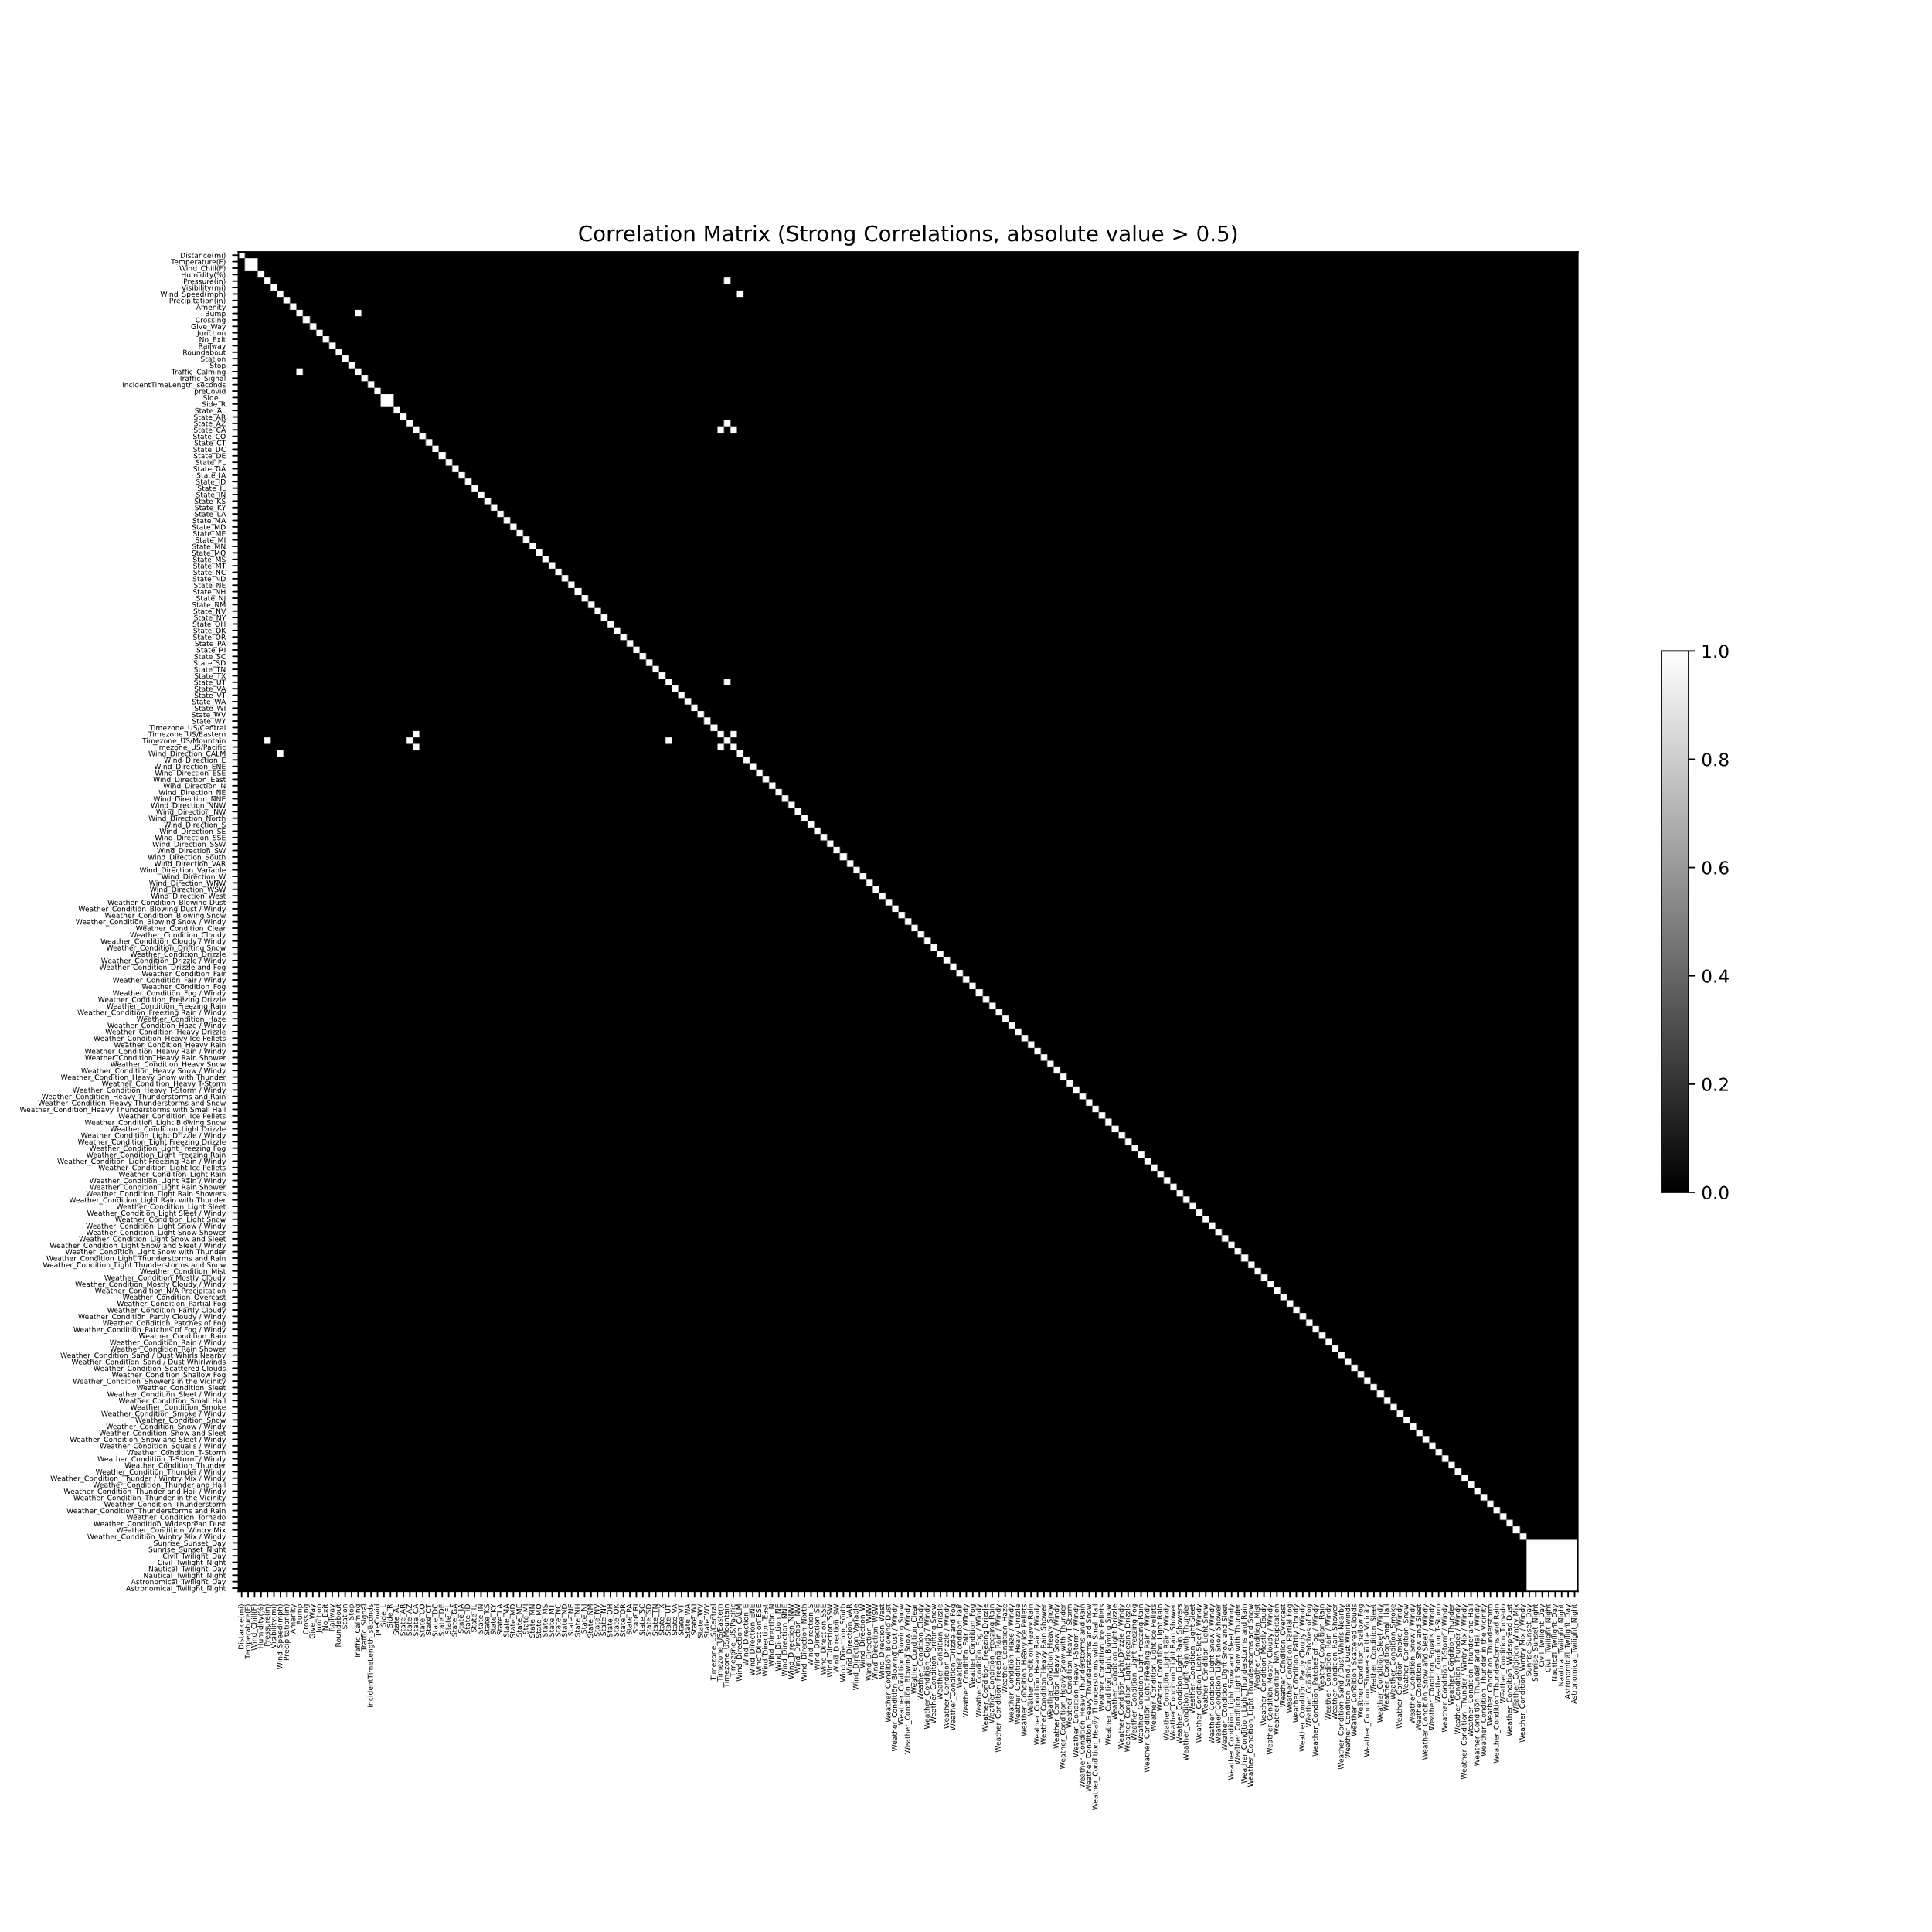
Pearson Correlation Matrix of Features
A
Pearson correlation matrix: all variables in raw data
Variables are not highly correlated among each other
Pearson correlation matrix: all variables in raw data
Binary Image: white pixels for abs(corr)>0.5 i.e. strong correlations

Slide 9
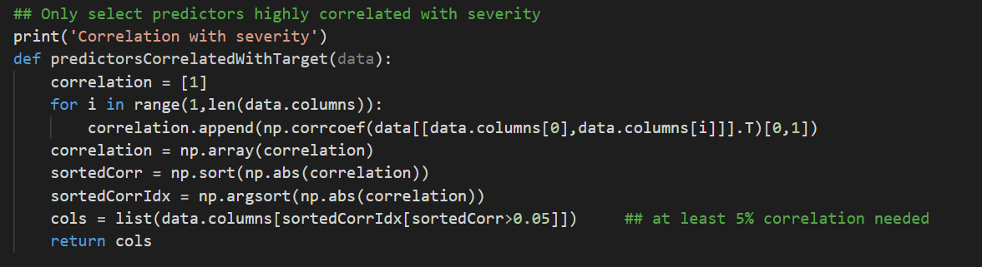
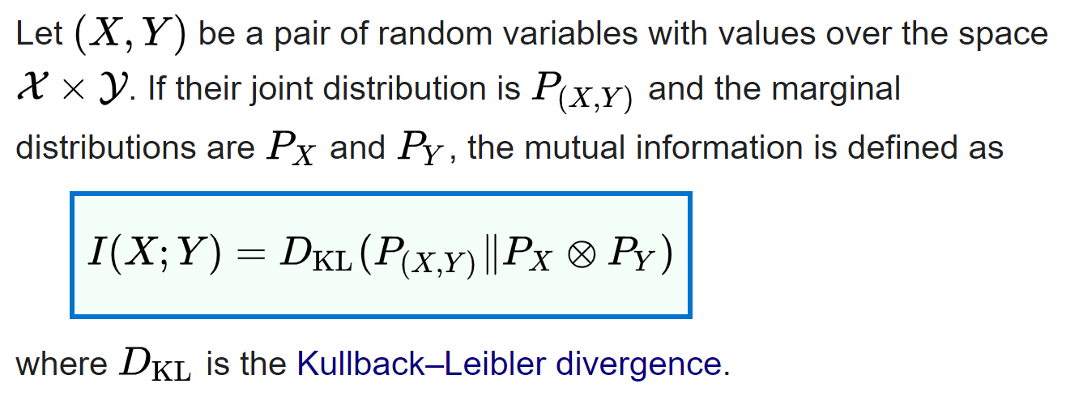
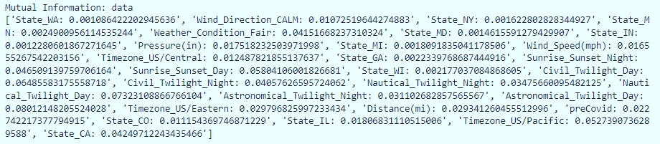
Feature Selection
Y
Correlation matrix criterion: correlation of possible features with target.
If abs(corr)>0.05, then we select that feature.
Observation: Selected features have high mutual information with target variable as compared to other variables.

Slide 10
Base Model and Evaluation Metrics

Slide 11
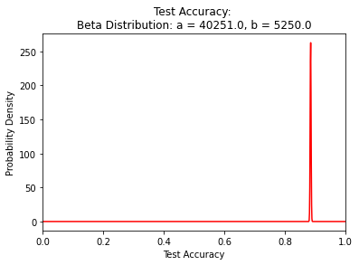
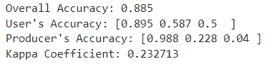
Base model from literature: Logistic Regression
Y
Target: Accident Severity (low:2, medium:3, high:4)
Predictors: All selected features (continuous and one-hot categorical)
User’s accuracy (False Positive): %age of predictions classified as class A that were actually class A.
Producer’s accuracy (False Negative): %age of actual class A predicted correctly as class A.
Kappa coefficient: Agreement of the model with reality. If confusion matrix has diagonals significantly higher than off-diagonals, kappa coefficient is high.
Very Good Classification Performance from base model!!
But is it really? NO!!!!!
These metrics are computed from confusion matrix
Low producer’s accuracy for class of highly severe accidents. This means the model can’t detect such cases reliably at all.
If implemented real-time for situations where the goal is to detect rare, but catastrophic events, this model would result in false negatives.

Slide 12
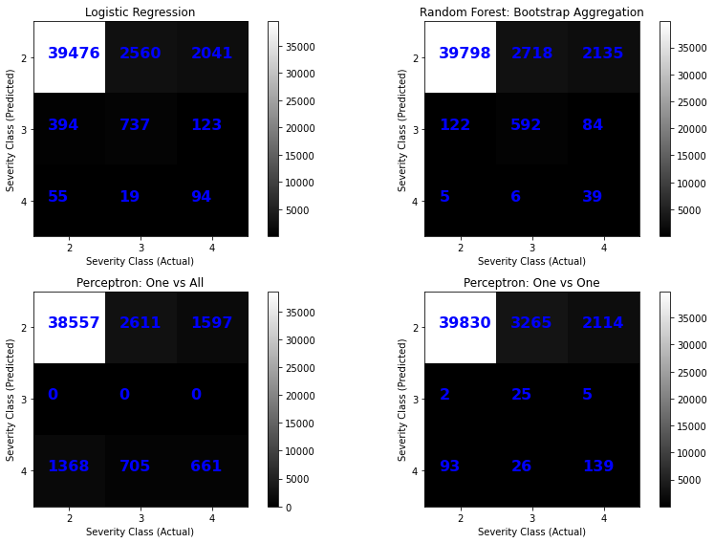
Why Confusion Matrices?
Y
Major problem: unbalanced class membership among target variables
We had a dataset in which the class for low severity accidents (class 2) is very highly represented, which highly severe accidents (class 3 and 4) were less in number (less than 30,000 each out of more than 800,000 observations). Hence, every model resulted in good classification for less severe accidents at the expense of highly severe accidents.
We identified this imbalance using confusion matrices.
This resulted in low producer’s accuracy.
Hence, accuracy on test set is not the best way to evaluate models meant to detect/identify/classify rare events.
Confusion matrix gives a more thorough picture

Slide 13
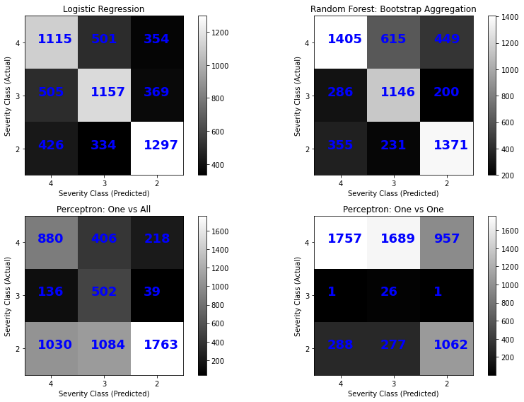
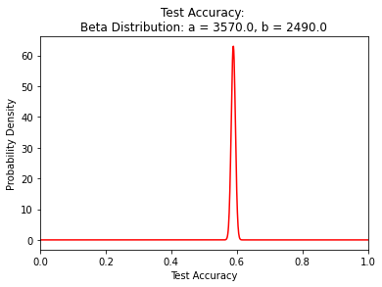
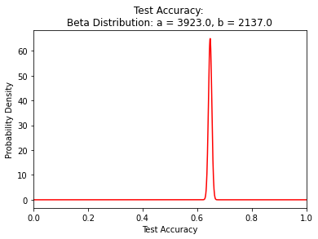
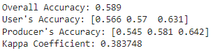
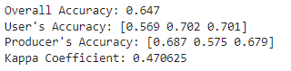
Major problem: unbalanced class membership among target variables
Y
Remedies
Use confusion matrix instead of just overall accuracy as the model performance metric.
Resample training data to have equal representation of each class.
Logistic Regression
Random Forest w/Bagging
(base model)

Slide 14
Algorithms

Slide 15
Algorithms
Y
A
Random Forest with Bootstrap Aggregation
Train multiple decision trees (weak learners) on bootstrap datasets (i.e. randomly selected observations with replacement). Classify through voting among overfitted weak-learners.
Random Forest with Adaptive Boosting
Train multiple decision trees (weak learners) on randomly selected observations. Subsequent weak learners compensate for training error of predecessors (Boosting).
Perceptron: One vs. All and One vs. One (refer next slide for methodology)
Train multiple binary classifiers using two different schemes to select binary classifiers. Pick the most confident classification (One vs All) or the most popular classification (One vs One)
Support Vector Machine: One vs All and One vs One
Same strategy as perceptron, but SVM didn’t scale well with number of observations. As a result, we only trained it on only 10000 observations.
Neural Networks
Fully connected neural network from scikit-learn implemented. To do: explore more using tensorflow

Slide 16
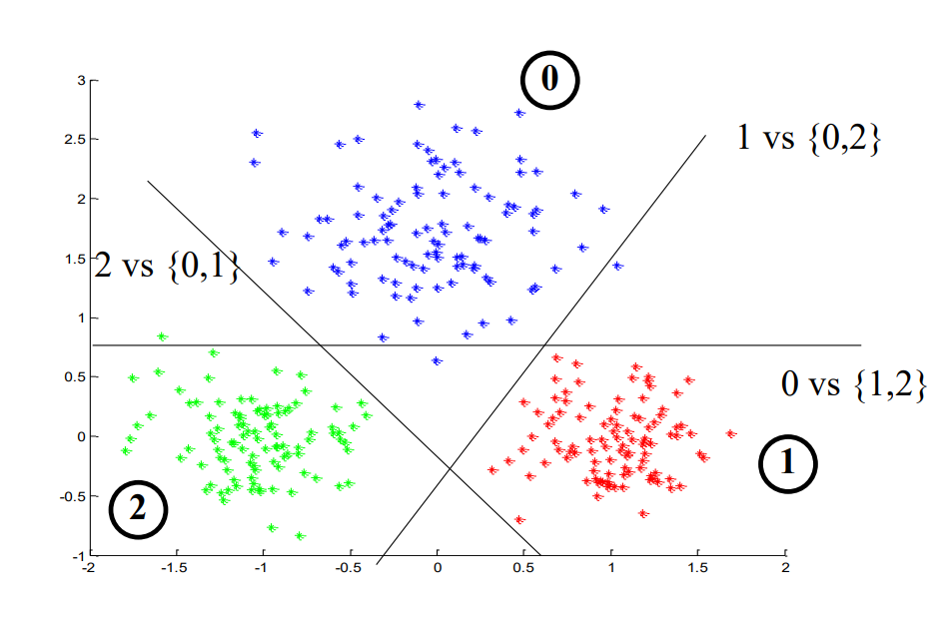
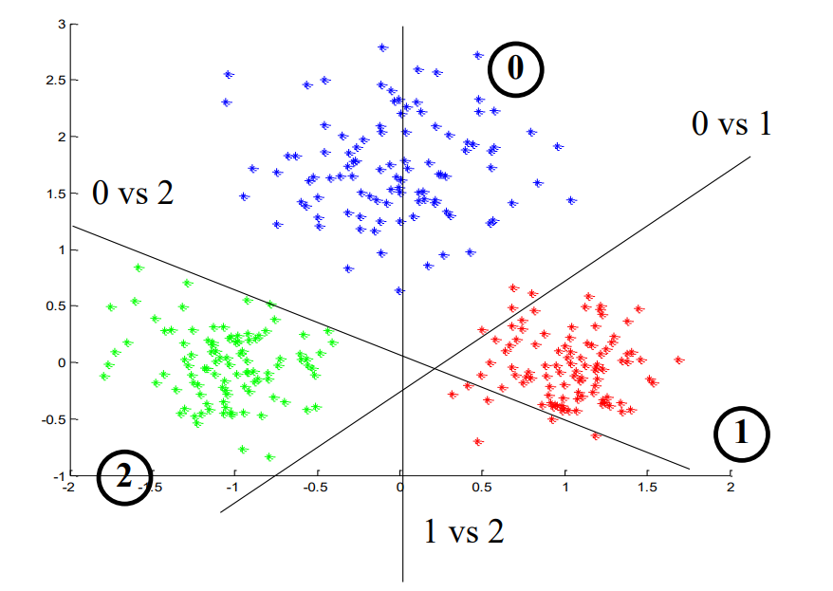
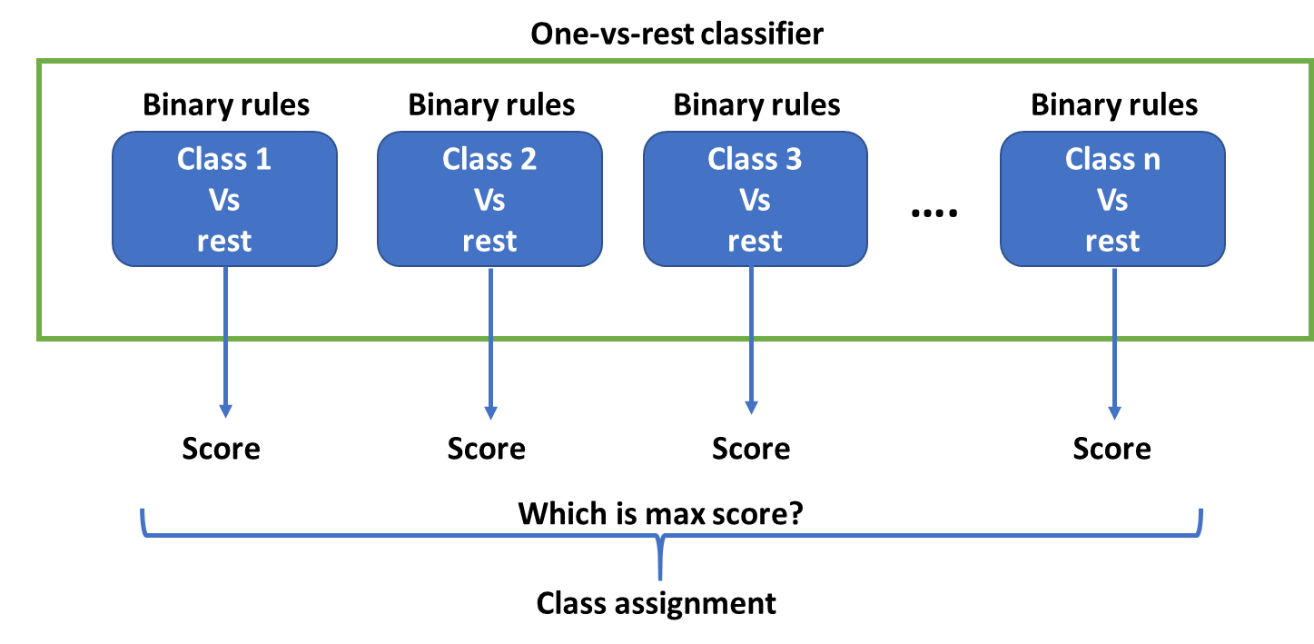
Algorithms: One vs All and One vs One Methodology
Y
One vs All
Warning: BUT these strategies are heuristic-based
One vs One
One vs All: choose the most confident class among all classes predicted as True.
One vs One: choose the class with most votes
Source: https://people.cs.pitt.edu/~milos/courses/cs1675-Spring2019/Lectures/class15b.pdf

Slide 17
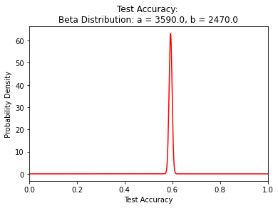
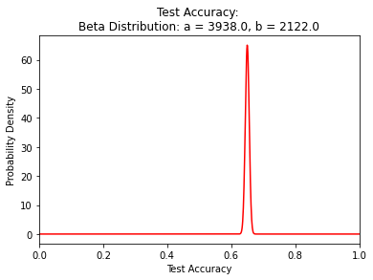
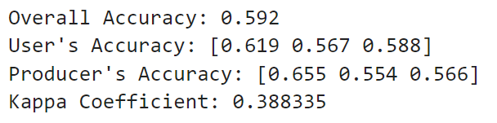
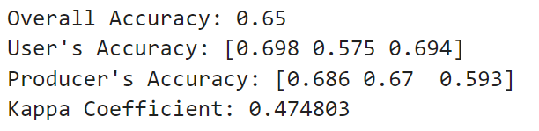
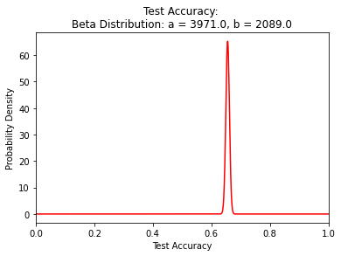
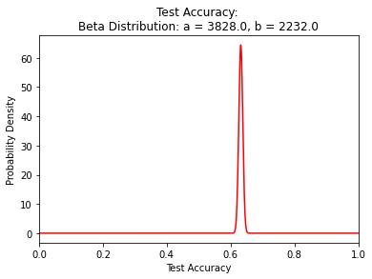
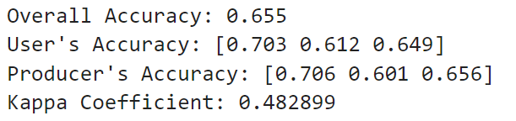
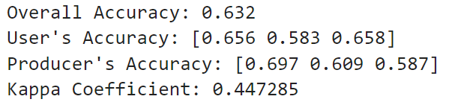
Results: Model Performance (Multiclass: Not heuristic methods)
A
Logistic Regression:
Training Time: 53.2 seconds
Random Forest w/Bagging
Training Time: 7.8 seconds
Random Forest w/AdaBoost
Training Time: 18.5 seconds
Neural Net
(3 hidden layers)
(50 hidden units)
Training Time: 142.6 seconds
Best Model

Slide 18
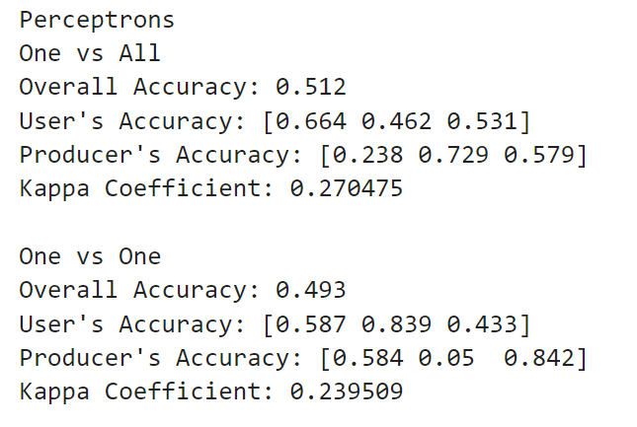
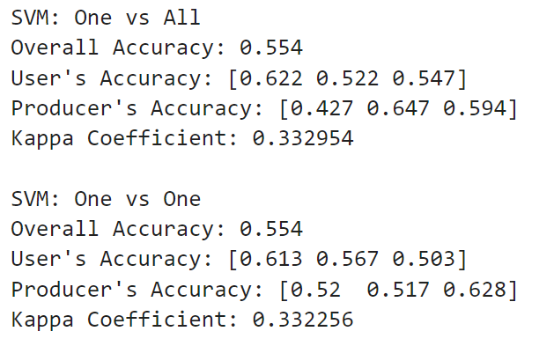
Results: Model Performance (Multiclass: heuristic methods)
A
Heuristic methods don’t perform well as compared to other methods.

Slide 19
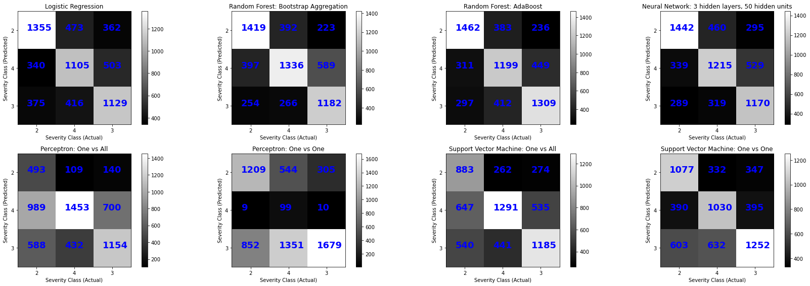
Results: Confusion Matrices
Y
Perceptron (One vs One) performs worst in terms of correctly classifying high-severity cases.
Perceptron (One vs All) performs worst in terms of correctly classifying low-severity cases.
Random Forest with AdaBoost is the best classifier overall.

Slide 20
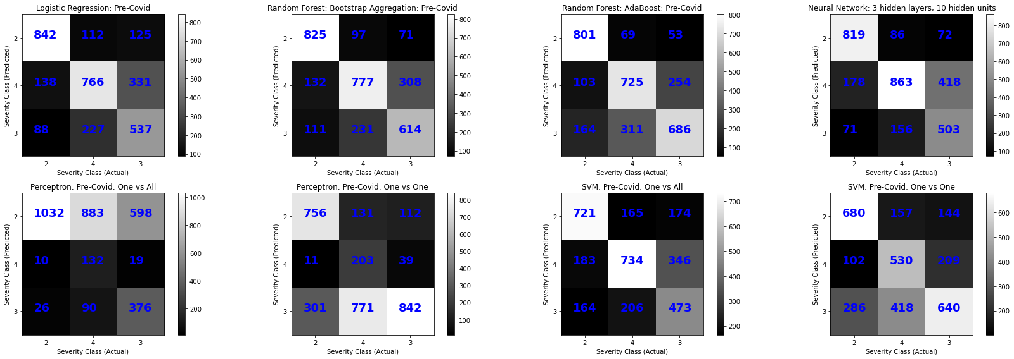
Results: Confusion Matrices
Y
We trained models on data from Pre-Covid era (more high-severity incidents) only.
Random Forests are still the best models.

Slide 21
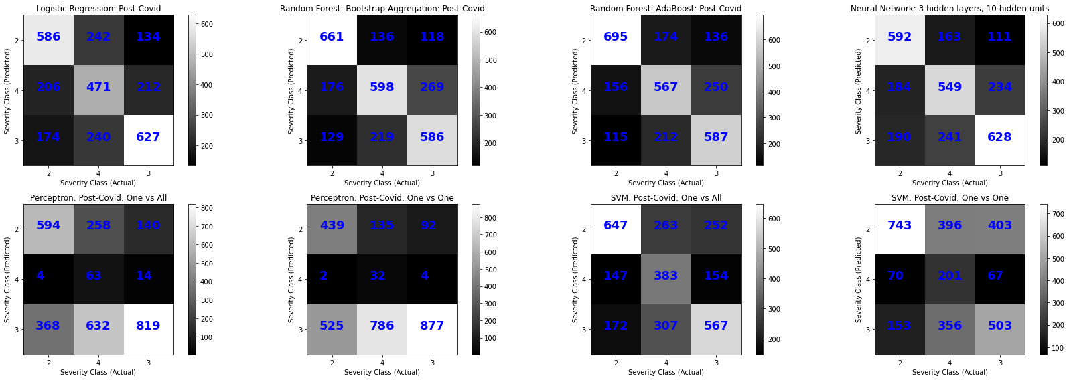
Results: Confusion Matrices
Y
We trained models on data from Post-Covid era (less high-severity incidents) only.
Random Forests are still the best models.

Slide 22
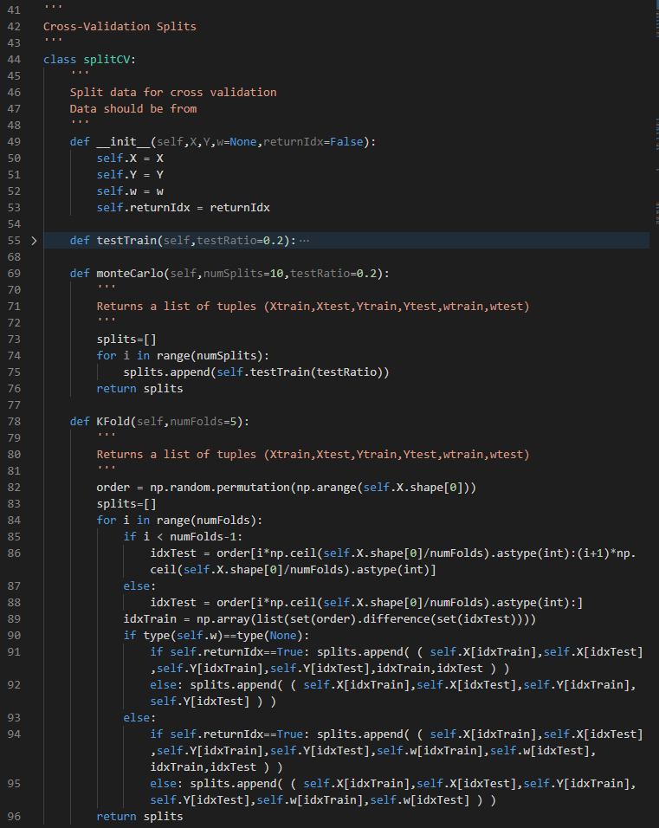
Future Work
Y
Binomial significance tests for new models vs base model
Coded function in homework
Model accuracy credible intervals
Coded function in homework
Explore Neural network architectures in tensorflow
Cross-Validation: K-Fold, Monte-Carlo
Coded function to perform data splits (see screenshot)
Function already tested on research work datasets

Slide 23
Division of Work
Red highlighted tasks are on the To-Do List
Yuvraj
Feature Selection: data cleanup
Base Model: Logistic Regression
Random Forest with Adaptive Boosting
Perceptron: One vs. All, One vs. One
Neural Networks
Confusion matrix metrics and cross-Validation
Integrating the main script to run all models and validation
Abdirashid
Feature Selection: correlation matrix and selection criteria
Random Forest with Bootstrap Aggregation
Support Vector Machine: One vs. All, One vs. One
Binomial significance testing
Credible intervals of test accuracy.

Slide 24
Thank you!!!
Any Questions?

Slide 25
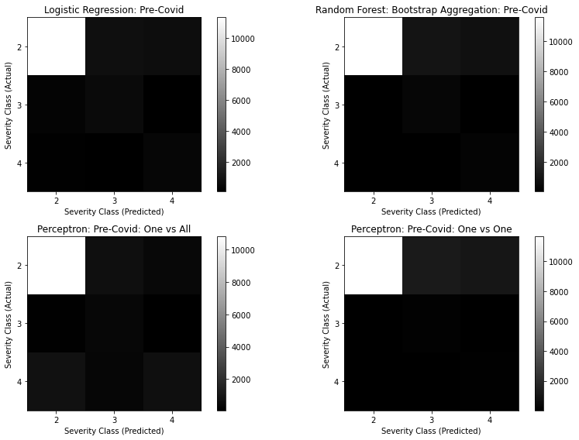
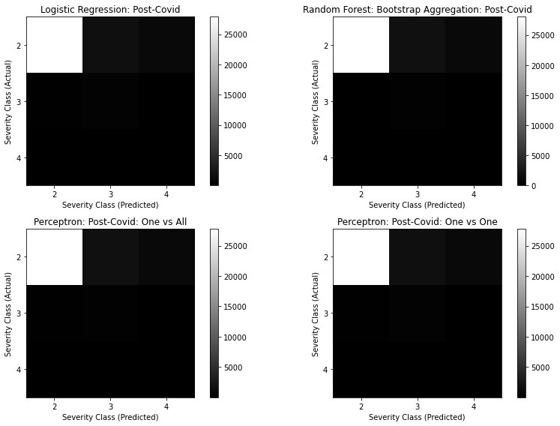
Appendix: Models (Unbalanced class membership)

Slide 26
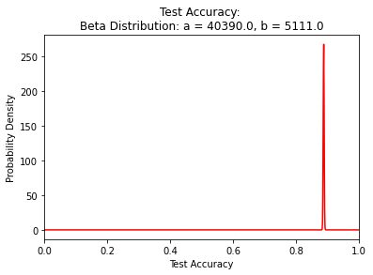
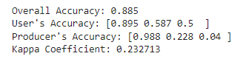
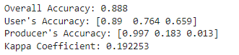
Appendix: Models (Unbalanced class membership)

Slide 27
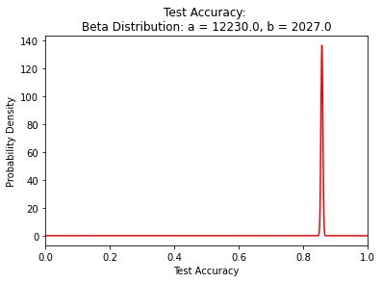
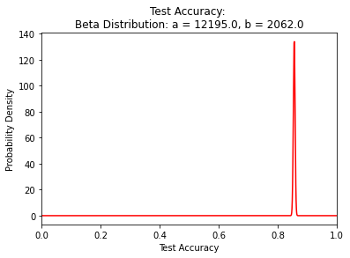
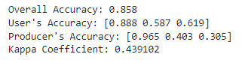
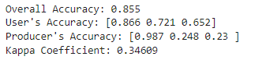
Appendix: Models (Unbalanced class membership)

Slide 28
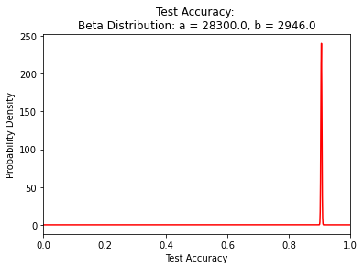
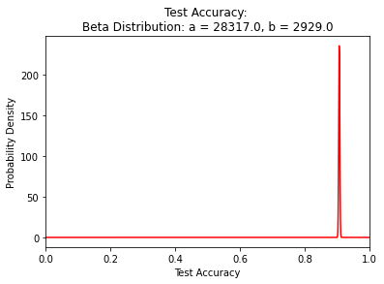
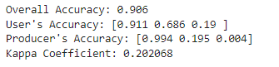
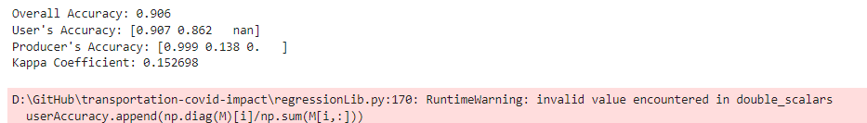
Appendix: Models (Unbalanced class membership)

Slide 29
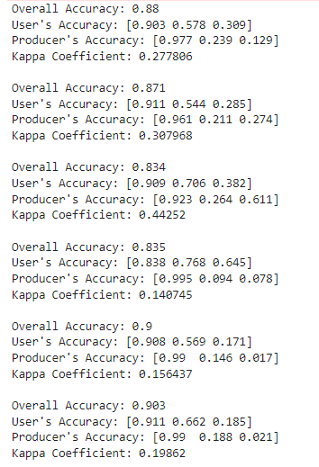
Appendix: Models (Unbalanced class membership)
Data: Perceptron One vs All
Data: Perceptron One vs One
Data Pre-Covid: Perceptron One vs All
Data Pre-Covid: Perceptron One vs One
Data Post-Covid: Perceptron One vs All
Data Post-Covid: Perceptron One vs One

